Slide 1
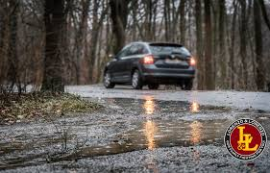
CAR ACCIDENT – SEVERITY-SEATTLE

Slide 2
Business Understandings:
Seattle Car Accident Data: It happens when the driver is not paying enough attention on road. Like talking on phone, Speeding, Consuming drugs, in-take of alcohol. Not following traffic rules.
To reduce frequent happening of car accidents, an ML algorithm must be developed to predict the severity of an accident given the current weather, road and visibility conditions. When conditions are bad, this model will alert drivers to remind them to be more careful.

